Slide 1
Baseline Results on Field Data (15th April)
(Only Tongue, Fingernail and Palm)

Slide 2
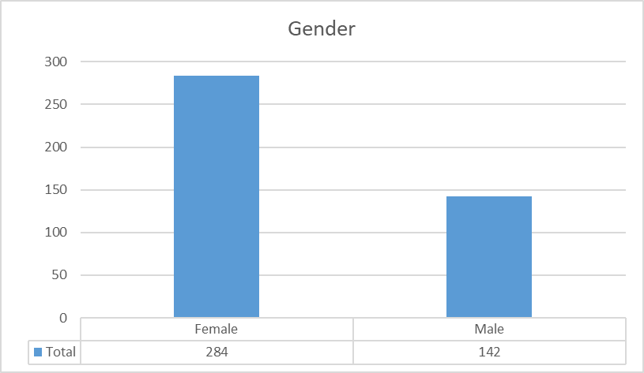
Data Analysis on Blood Reports: Gender

Slide 3
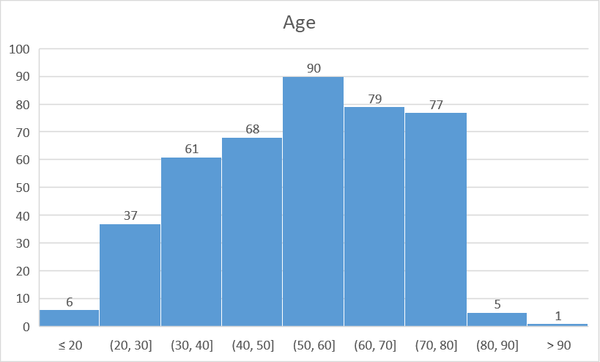
Data Analysis on Blood Reports: Age

Slide 4
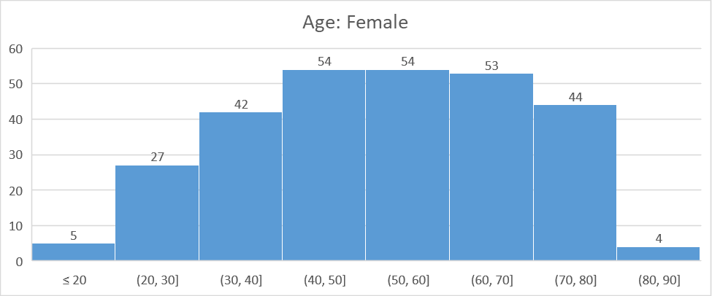
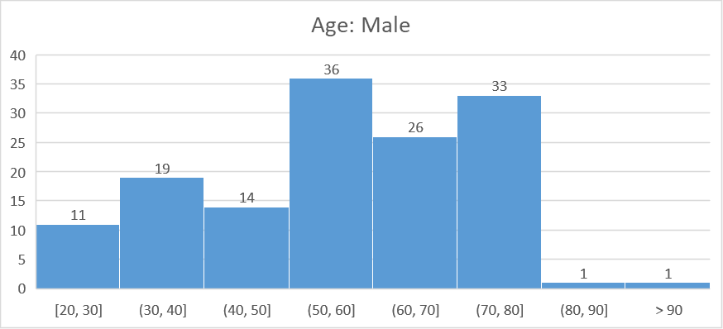
Data Analysis on Blood Reports: Age
 | <=20 | (20,30] | (30,40] | (40,50] | (50,60] | (60,70] | (70,80] | (80,90] | >90
Female | 5 | 27 | 42 | 54 | 54 | 53 | 44 | 4 | 0
Male | 0 | 11 | 19 | 14 | 36 | 26 | 33 | 1 | 1

Slide 5
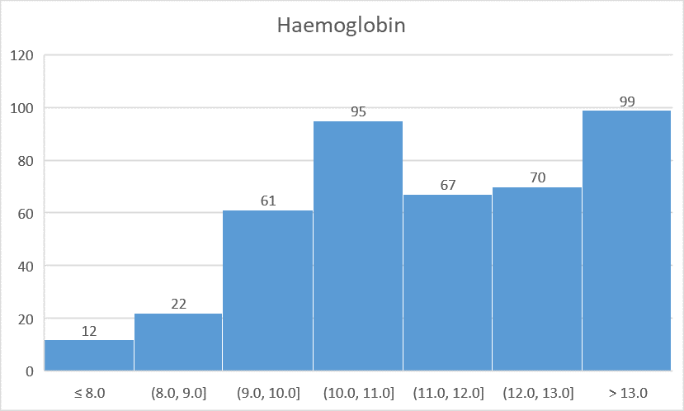
Data Analysis on Blood Reports: Hb

Slide 6
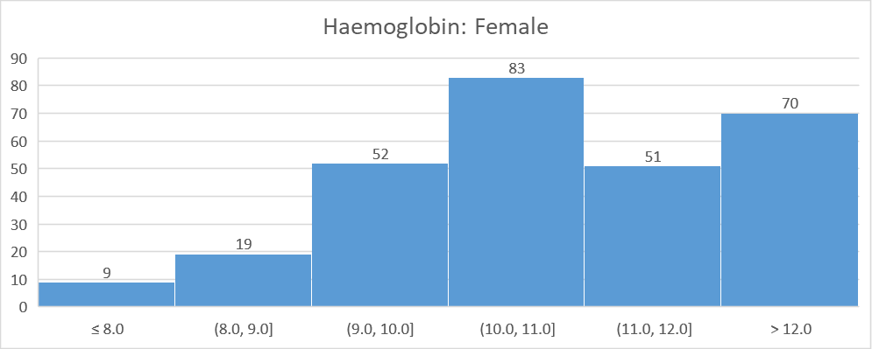
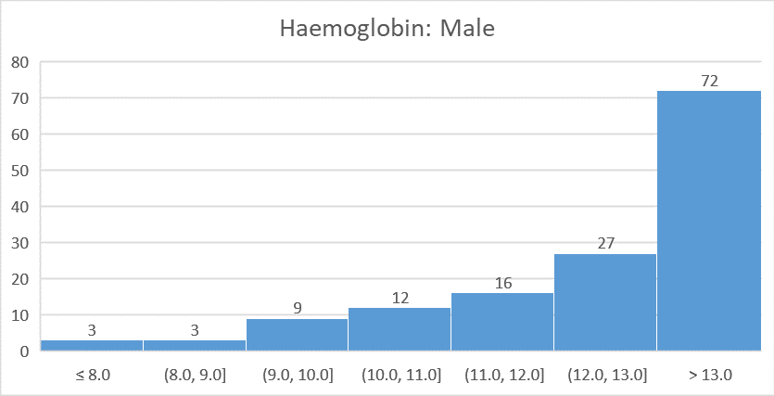
Data Analysis on Blood Reports: Hb
Anemia Type | Female | Male
Severe Anemia | 9 | 3
Moderate Anemia | 154 | 24
Mild Anemia | 51 | 43
No-Anemia | 70 | 72

Slide 7
Right Fingernail

Slide 8
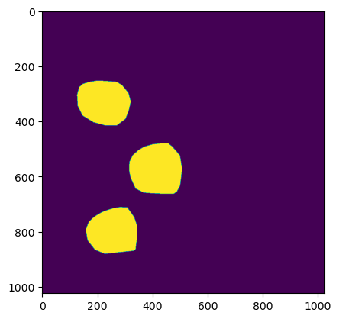
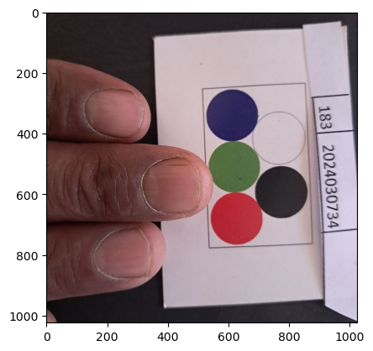
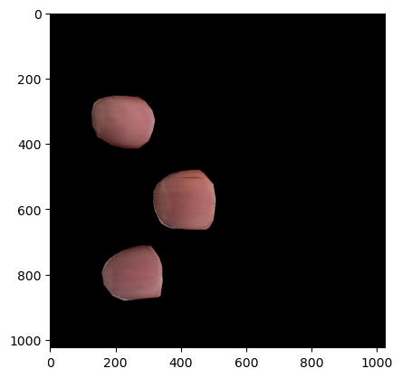
D
A
T
A
Mask
Original Image
Input Data

Slide 9
Results
 | Train - 70 | Test - 30 | Test - 30 | LOOCV | LOOCV | PyCaret
MAE | 0.00065(XGB) | 1.17(RF) | 1.18(LR) | 1.28(CB) | 1.29(RF) | 1.3(RF)
R2 | 1.0000(XGB) | 0.26(RF) | 0.23(LR) | 0.30(CB) | 0.29(RF) | 0.26(RF)
 | Accuracy | Precision | Sensitivity | Specificity
Paper (SVM) | 0.80 ± 0.06 | NA | 0.75 ± 0.14 | 0.82 ± 0.08
70/30 Split (RF) | 0.71 | 0.61 | 0.29 | 0.91
Leave One Out (RF) | 0.79 | 0.58 | 1.0 | 0.71
PyCaret (RF) | 0.74 | 0.5 | 0.26 | 0.91

Slide 10
Left Palm

Slide 11
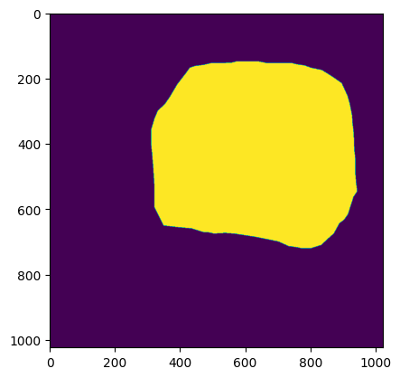
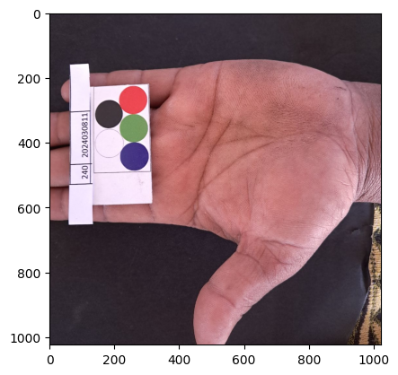
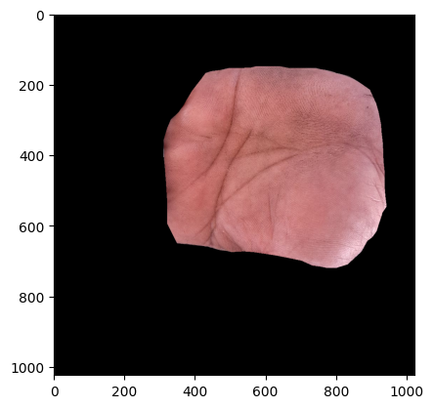
D
A
T
A
Mask
Original Image
Input Data

Slide 12
Results
 | Train - 70 | Test - 30 | Test - 30 | LOOCV | LOOCV | PyCaret
MAE | 0.00063(XGB) | 1.30(LR) | 1.31(RF) | 1.26(LR) | 1.31(RF) | 1.28(ridge)
R2 | 1.0000(XGB) | 0.33(LR) | 0.34(RF) | 0.29(LR) | 0.26(RF) | 0.15(ridge)
 | Accuracy | Precision | Sensitivity | Specificity
Paper (SVM) | 0.80 ± 0.06 | NA | 0.75 ± 0.14 | 0.82 ± 0.08
70/30 Split (LR) | 0.70 | 0.43 | 0.41 | 0.81
Leave One Out (LR) | 0.79 | 0.58 | 1.0 | 0.7
PyCaret (ridge) | 0.74 | 0.72 | 0.3 | 0.95

Slide 13
Tongue

Slide 14
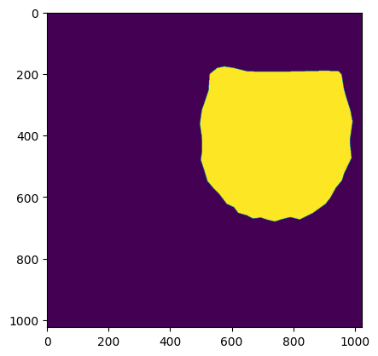
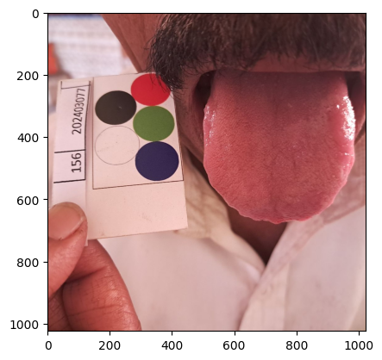
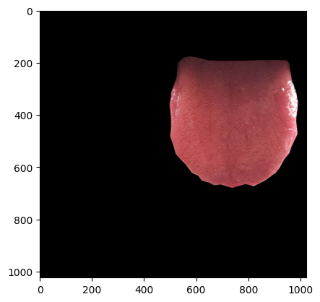
D
A
T
A
Mask
Original Image
Input Data

Slide 15
Results
 | Train - 70 | Test - 30 | Test - 30 | LOOCV | LOOCV | PyCaret
MAE | 0.00053(XGB) | 1.28(BR) | 1.35(LR) | 1.33(LR) | 1.36(RF) | 1.31(RF)
R2 | 1.0000(XGB) | 0.096(BR) | 0.02(LR) | 0.24(LR) | 0.23(RF) | 0.197(RF)
 | Accuracy | Precision | Sensitivity | Specificity
Paper (SVM) | 0.80 ± 0.06 | NA | 0.75 ± 0.14 | 0.82 ± 0.08
70/30 Split (BR) | 0.74 | 0.5 | 0.35 | 0.88
Leave One Out (LR) | 0.79 | 0.58 | 1.0 | 0.71
PyCaret (RF) | 0.61 | 0.26 | 0.32 | 0.71

Slide 16
Comparison of Results
 | Algorithm | Method | MAE | R2
Right Nail | CatBoost | LOOCV | 1.28 | 0.30
Left Palm | Linear Regression | LOOCV | 1.26 | 0.29
Tongue | Linear Regression | LOOCV | 1.33 | 0.24

Slide 17
Comparison of Results
 | Anatomy | Accuracy | Precision | Sensitivity | Specificity
Paper (SVM) | Eye | 0.80 ± 0.06 | NA | 0.75 ± 0.14 | 0.82 ± 0.08
Leave One Out (RF) | Right Nail | 0.79 | 0.58 | 1.0 | 0.71
Leave One Out (LR) | Left Palm | 0.79 | 0.58 | 1.0 | 0.7
Leave One Out (LR) | Tongue | 0.79 | 0.58 | 1.0 | 0.71

Slide 18
Moving Forward (Next 2 weeks)
Part 1: Data
Data Cleaning
Error Handling
Exploratory data analysis
More annotations
Part 2: Modelling
Trying out models with more data
Adding more features
Improving results

Slide 19
THANK YOU

